Slide 1

Analyzing Student Test Scores
Caleb Andree, Chiamaka Ebulu, Josephine Ekenya, Zain Zaidi

Slide 2
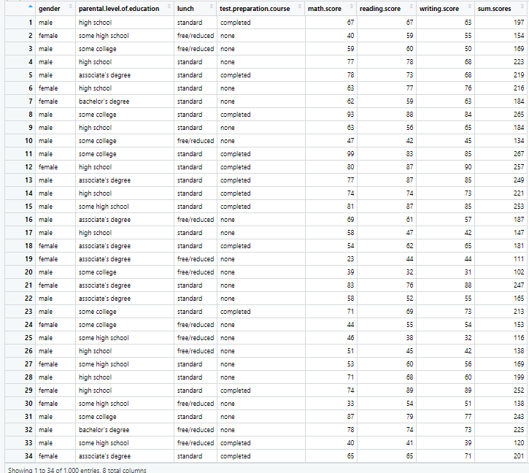
Our Dataset
Consists of 1000 student scores on a variety of subjects
Contains information about the student’s parental level of education, lunch type and if they completed a test prep course
Math, reading and writing scores were all summed together in a “sum.scores” column

Slide 3
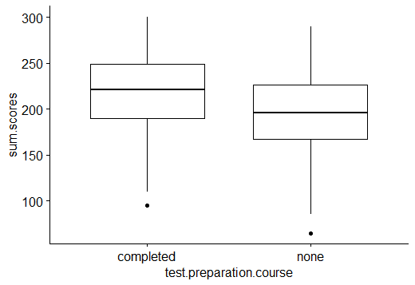
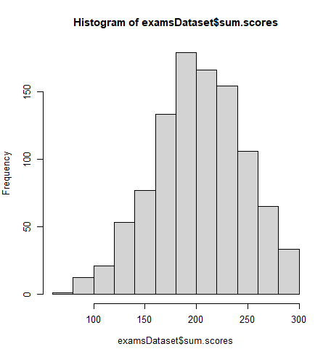
Descriptive Statistics for the Dataset
After exploring the data, we found trends that pointed towards students performing better after completing test preparation courses
335 students took a test prep course, with the mean of the scores being 218
665 students did not take a test prep course, with the mean of the scores being 195

Slide 4
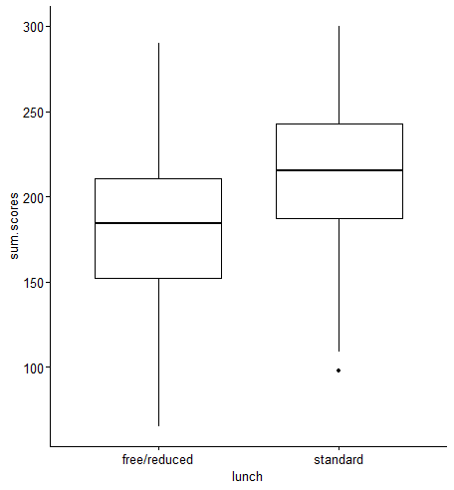
More Descriptive Statistics
Boxplot showing the difference in test scores of students who have free/reduced lunch compared to the standard lunch type
There is a trend showing that students with the standard lunch type perform better on the test
348 students have free/reduced lunch, with a mean score 183
652 students have the standard lunch type, with a mean test score of 214

Slide 5
Hypothesis and Research Questions
Do factors like lunch type, taking test preparation courses, and parental education have an effect on the test scores of students?
We are interested in seeing if all of these variables combined have a difference on the performance of students on the test
Hypothesis: There is a higher test average with students who have better financial circumstances (standard priced lunches, higher parental education, affording test prep courses)
Dependent variable: Student Test average
Independent variables: Financial circumstances (Lunch type, parental education, test prep courses)
Is there a difference in the test scores between female and male students?
We are interested in seeing how the test scores between female and male students compare with one another
Hypothesis: There is a difference in the test performance between female and male students
Dependent variable: Student Test Average
Independent variable: Gender (Female and Male)

Slide 6
Analysis Methods Chosen
Since there are multiple independent variables with a variety of conditions, we will be performing multiple significance tests for each category (test prep, lunch type, parental level of education, gender)
For the test preparation category, we will be conducting an Independent T-test and analyzing the test scores for that category
For the parental level of education category, we will be conducting a One Way Anova test and analyzing the scores from that category
For the gender category, we will be conducting an Independent two-sample T-test and analyzing the test scores for that category
For the lunch category, we will be conducting an Independent T-test and analyzing the test scores for that category

Slide 7
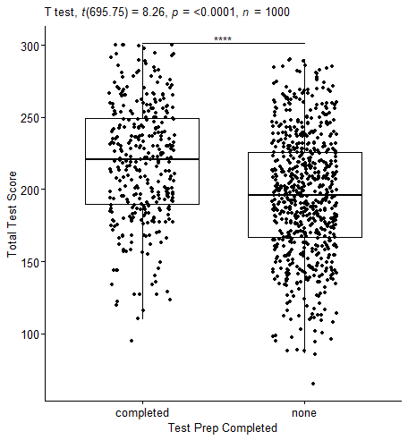
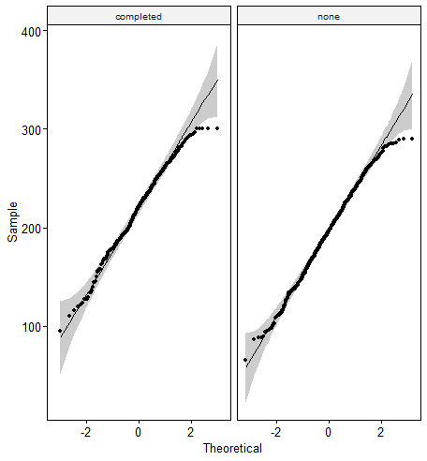
Test Preparation and Test Scores Analysis
After checking all assumptions, the test was able to be conducted
Independent T-test shows a p-value of less than 0.05, which means the data is statistically significant
Indicates that there is a relationship between student test scores and test preparation courses completed

Slide 8
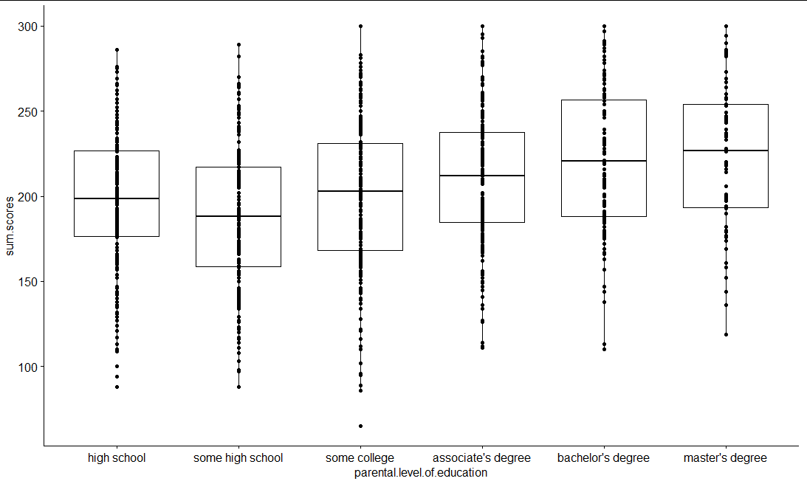
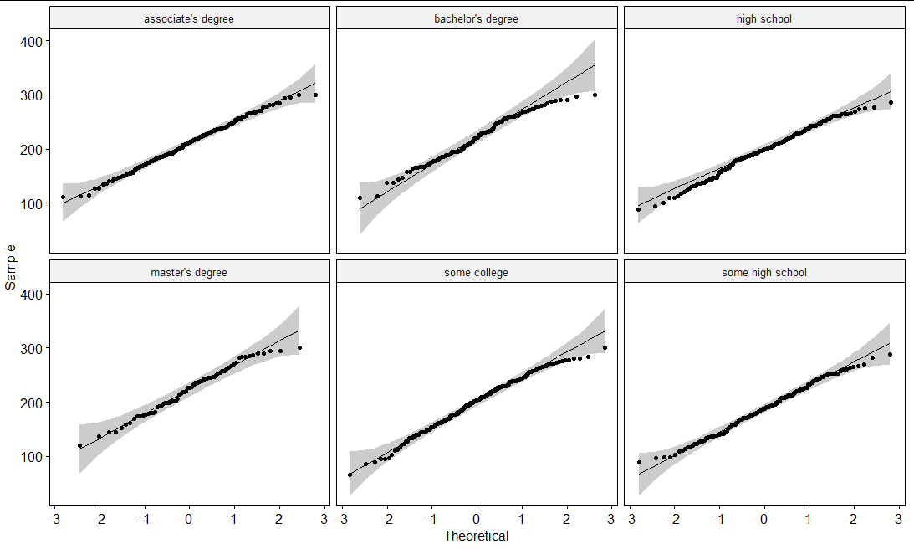
Parental Level of Education and Test Scores Analysis
After checking all the assumptions there are no extreme outliers
The P-value after running the anova test was less than 0.05 which is statistically significant.
After completing the One Way Anova test, it is to be suggested that parental level of education affects the students test scores

Slide 9
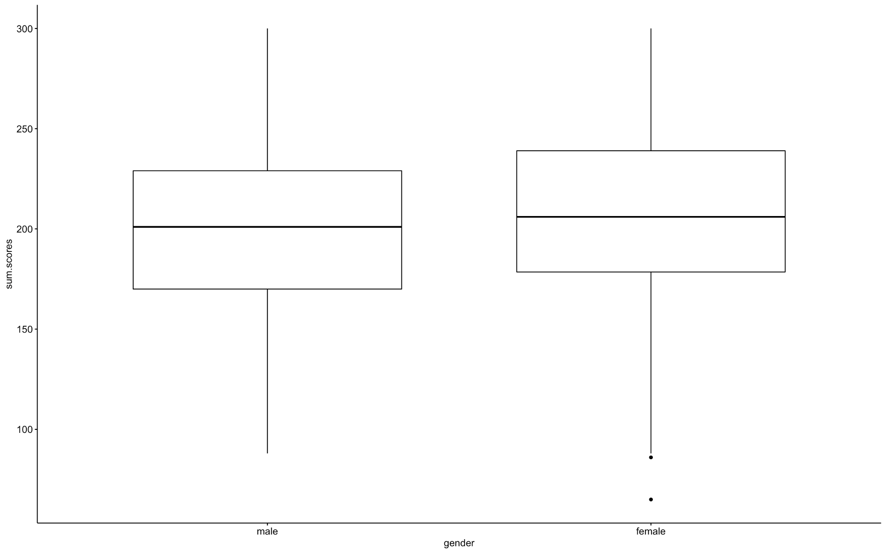
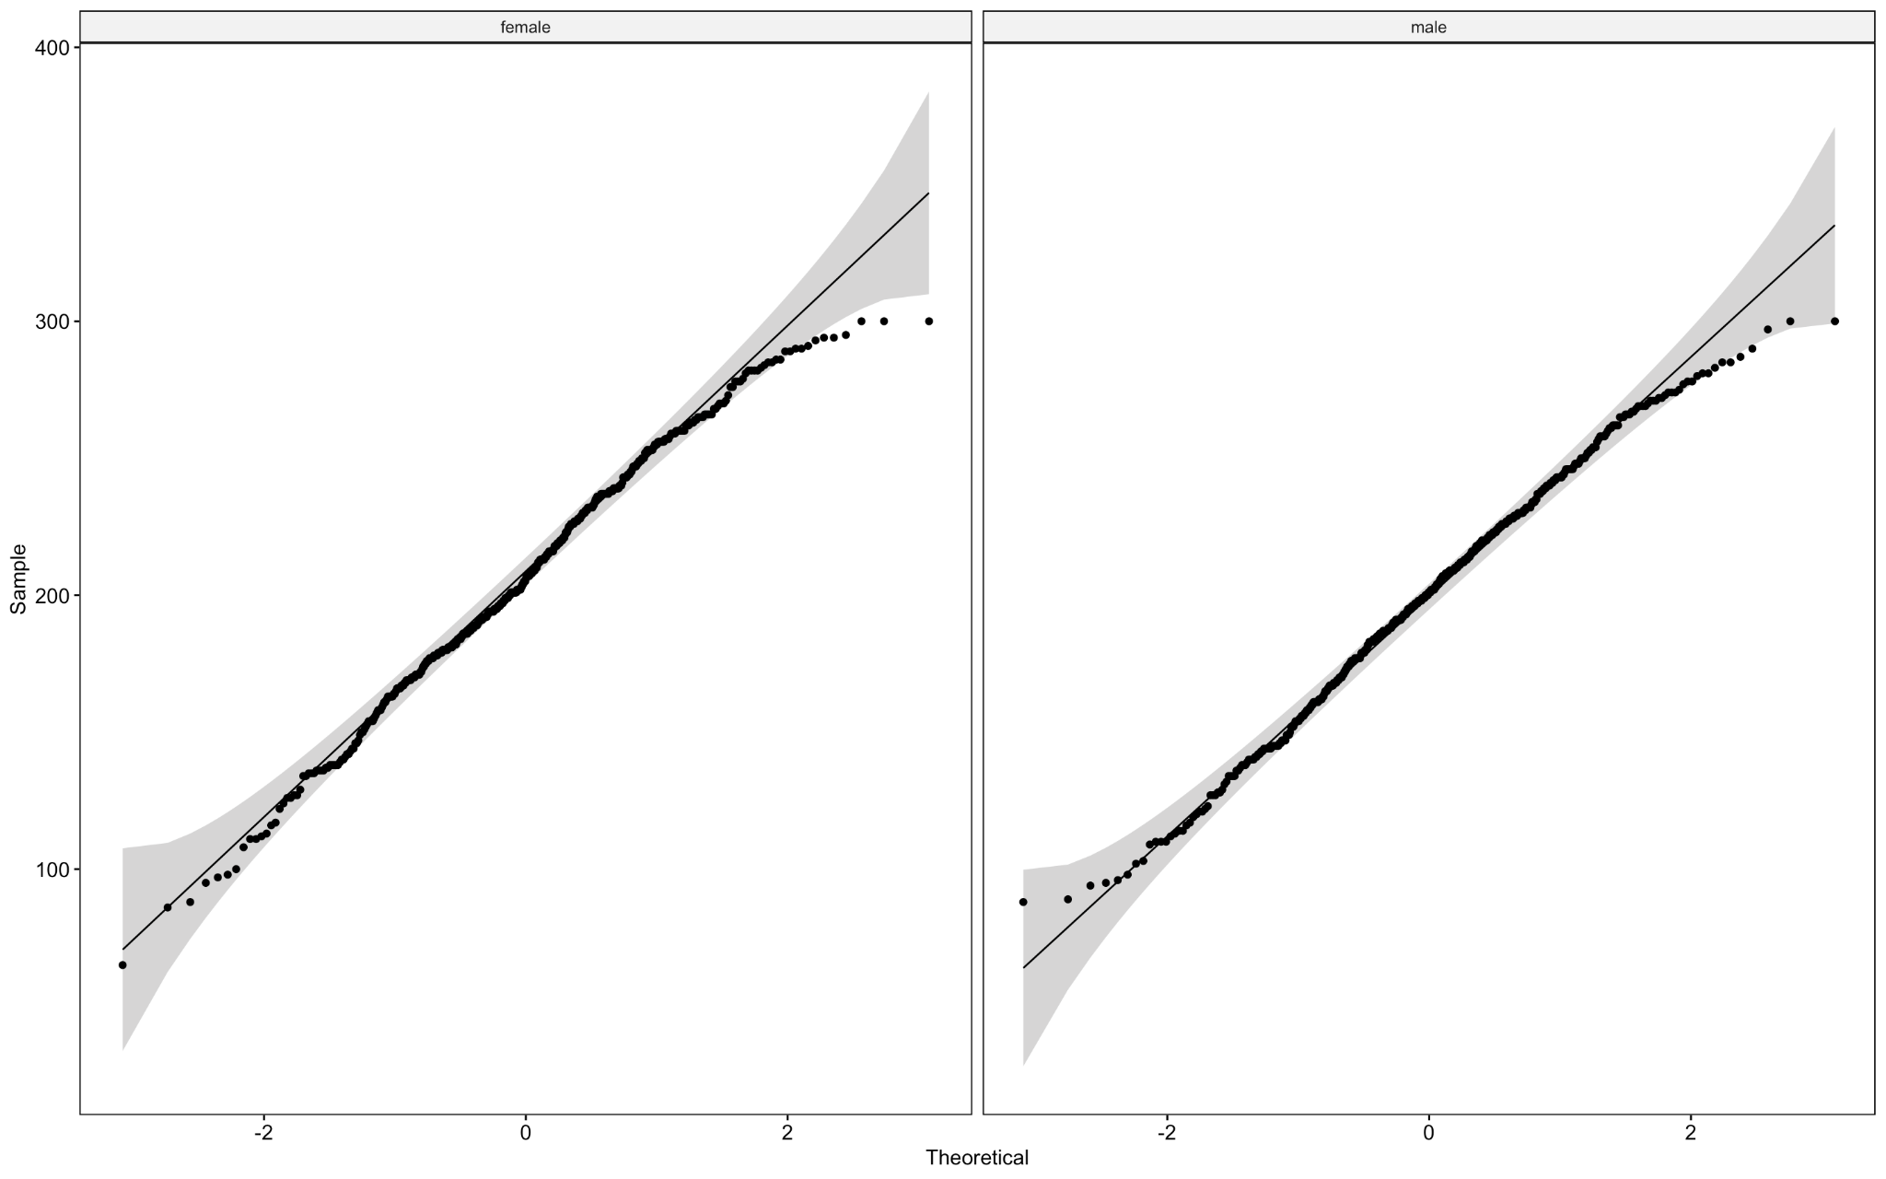
Gender and Test Scores Analysis
While checking for assumptions, two outliers were identified among the test scores for the female group, but they were not extreme
The P-value was 0.010, which is significantly smaller than 0.05
The normality test indicated that the data was normally distributed
The Independent Two-Sample T test indicates that there is a significant difference in test scores between the female and male student population

Slide 10
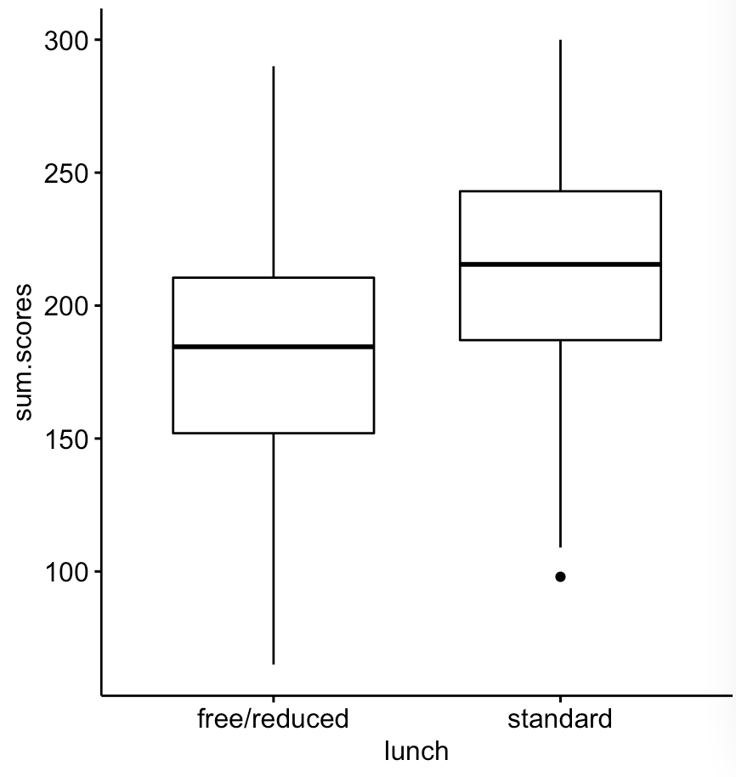
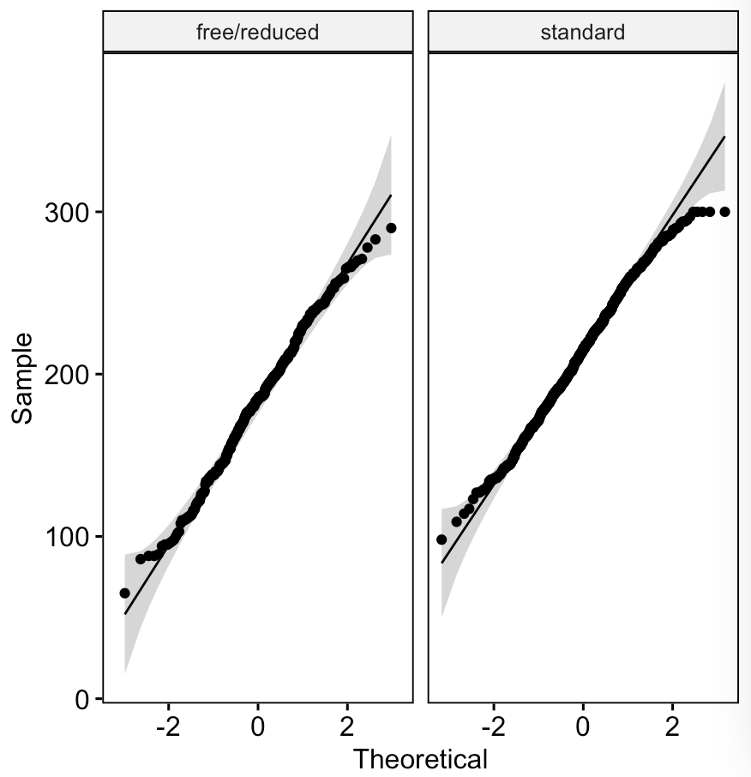
Lunch and Test Scores Analysis
When checking for assumptions to make prior to data analysis, there were no extreme outliers visible.
The P-Value was much less than 0.05, meaning it was statistically significant
The normality in the QQ plot on the right shows that the data is normally distributed
The Independent T-Test Showed a correlation between the type of lunch a student receives and their test score (see boxplot)

Slide 11
Interpretation of the Test Results - Test Preparation
There is a direct correlation between whether or not a student takes a test preparation course and their test grade
There is a higher test average for those who take a test preparation course
With a mean score of 218 for those who have taken a test preparation course, this is higher than the average for those who have not taken a test prep course, with a mean score of 195
Students who wish to do better on the test should take a course prior to taking the test

Slide 12
Interpretation of the Test Results - Parental Level of Education
Looking at the boxplot that compares the parental level of education to the corresponding students test scores, students whose parents have only obtained a high school diploma (or did not finish high school) seem to have lower test scores than the students whose parents attended college. Especially if they went on to obtain an associates, bachelors or masters degree.
After running Tukey’s multiple comparisons test, there was a significant difference between multiple groups that further emphasizes the differences in test scores between the students in each level of education category.

Slide 13
Interpretation of the Test Results - Gender
The population for the female test group was 483 and the population for the male test group was 517
The mean score of 207 for the female test group is higher than the mean score of 200 for the male test group
After checking all assumptions and computing the Independent Two-Sample T test, we can note that there is a difference in test scores between the two groups, with female students performing better on average

Slide 14
Interpretation of the Test Results - Lunch
When looking at the boxplot for lunch and its effect on test scores, we can see a clear difference in that the averages, extremes, and lower points.
Those with standard lunch are regularly scoring higher than those on free/reduced lunch. Even the only outlier amongst the standard lunch group is higher than the lowest extreme for those with free/reduced lunch.
The results align with the predicted normal distribution that is visible in the normality plot, meaning the results are statistically normal.

Slide 15
Final Interpretation of Test Results and Suggestions
Students from a better financial background perform better on tests, with female students performing better overall
There is a higher test average for those who take a test preparation course
Students whose parents have obtained an associates, bachelors or masters degree scored better than students whose parents only obtained a high school diploma (or did not finish high school)
Those with standard lunch are regularly scoring higher than those on free/reduced lunch
We suggest the development of a test preparation course for students from lower income backgrounds who wish to do better on the test
We suggest schools working more closely with students whose parents have not obtained any college degree
We suggest that more research be conducted to better understand why female students perform better than male students
We suggest that more research be conducted to understand the correlation between poor test scores and receiving free/reduced meals from school.
Some further research questions could include: how are the learning styles of female students different from male students? What are the study habits of students whose parents have college degrees compared to those that don’t? How does whether a student pays full price for their meals correlate to higher test scores?

